Slide 1

The most approprate solution
Waste Food
Managment
Date of the
Presentation
Presented by
group eighteen

Slide 2
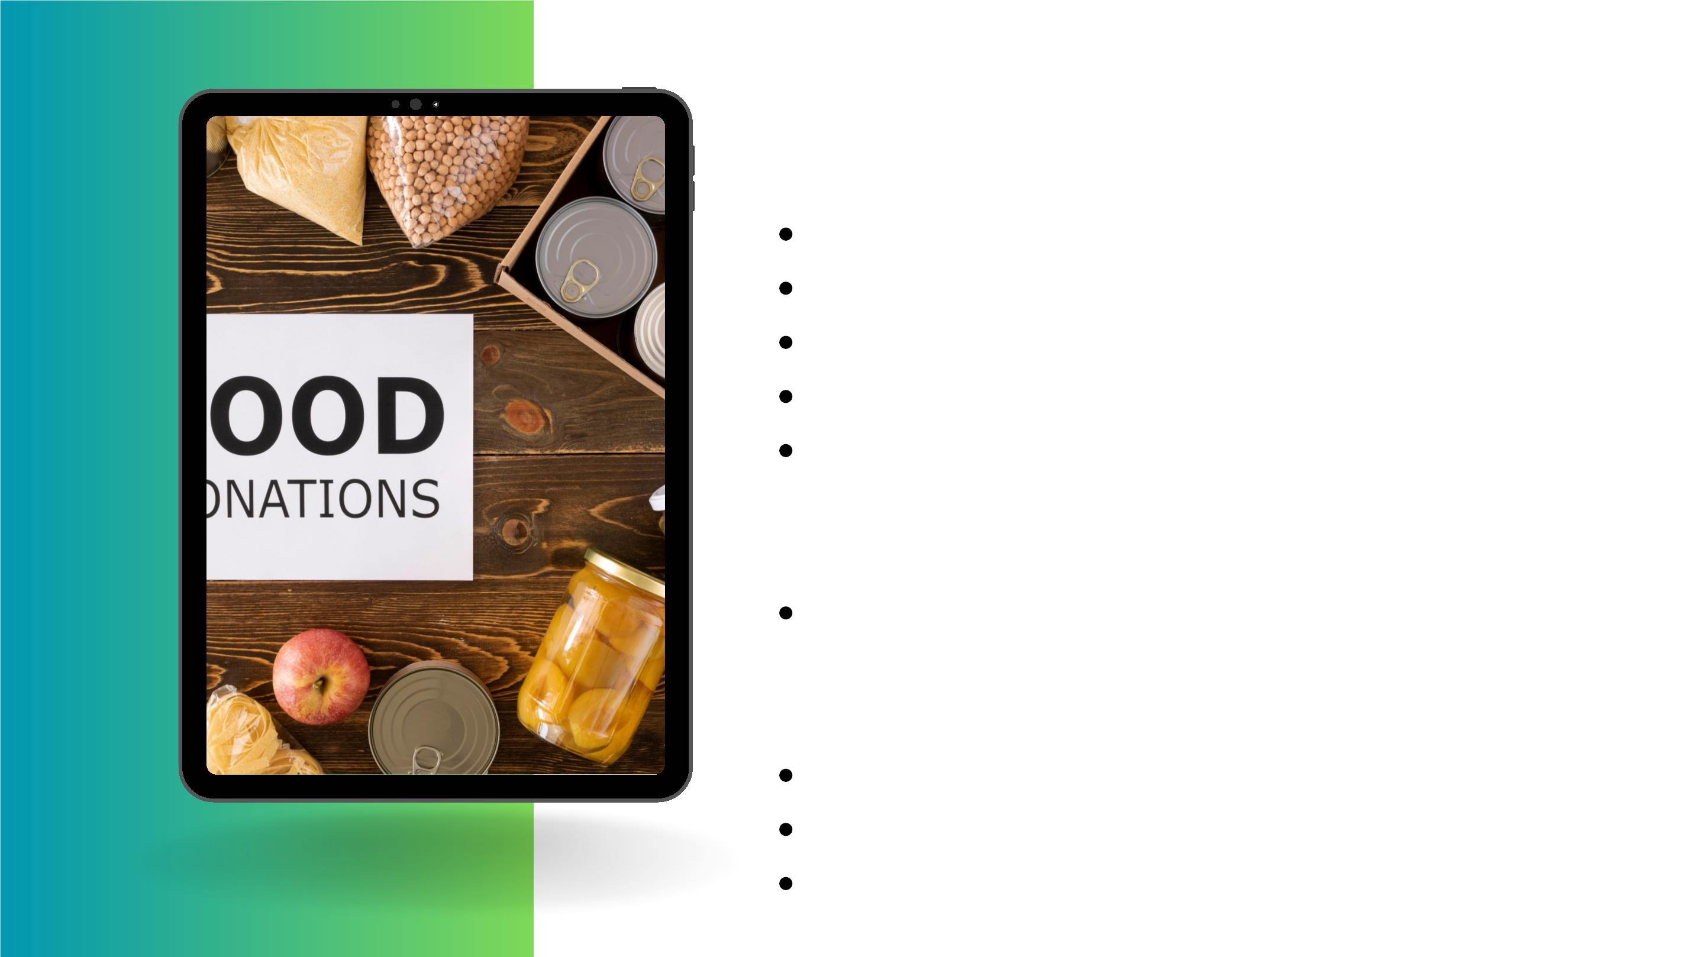
Outline
Problem................................................
Solution................................................
Description...........................................
Requirements.......................................
Functional............................................
1. Definition
2. Types
Nonfunctional ...................................
1. Definition
2. Types
Overview..............................................
Requirements Analysis..........................
Requirement specification.....................

Slide 3

Outline
1. Definition
2. System Requirement
3. User Requirements
i
4. Donor Requirements
5. Admin Requirements
6. Collector Requirements
7. Software Requirements
8. Deployment Requirement
9. finance Requirements

Slide 4
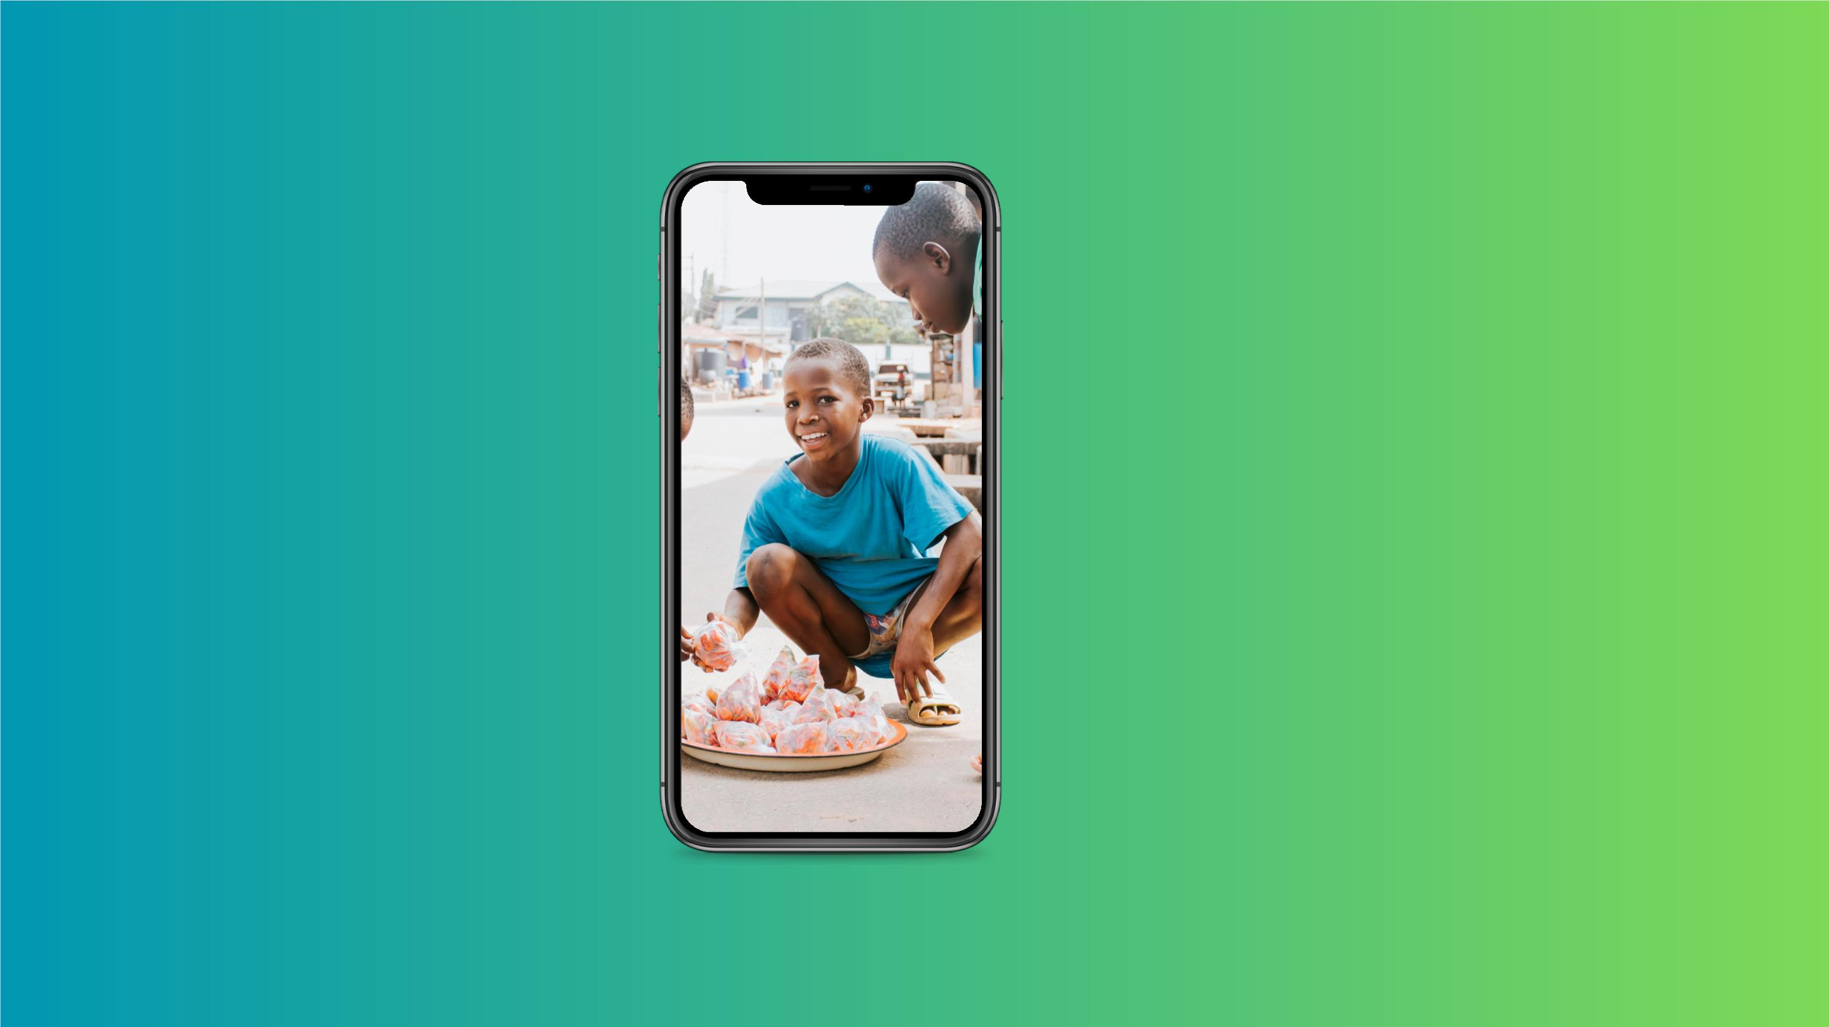
Problem!!
Food mangement is
one of the most
widely tke serious
subjects of all times.
but even in that there
are still people
without food nd
people throwing away
food
Solution!!
A food
Auction/Give away
native application
with a centralize
database system

Slide 5

Description
40
30
20
10
0
A native application build with
Android Studio(java, firebase) for
the giving out free food or at a
compensation(minimum
auctioning) .
DEC
JAN
FEB
MARCH APRIL
The application is to be created as
a mobile friendly, flexible
application. allowing people to give
out and take food free or at a
compensation
Food businesses in large cities are
particularly feeling the heat.
Visualize complicated and dense information with
graphs and charts. These are visual aids that help
add more context to the topic you are discussing.

Slide 6
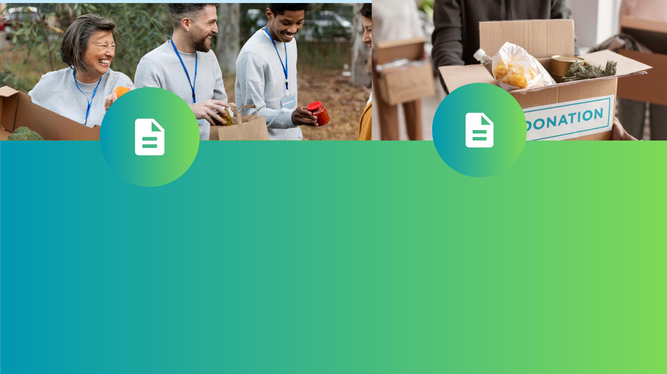
Requirements
NonFunctional
Functional
A nonfunctional requirement is a characteristic or constrain
that describes how a system should behave, but does not
Functional requirements are a set of

Slide 7
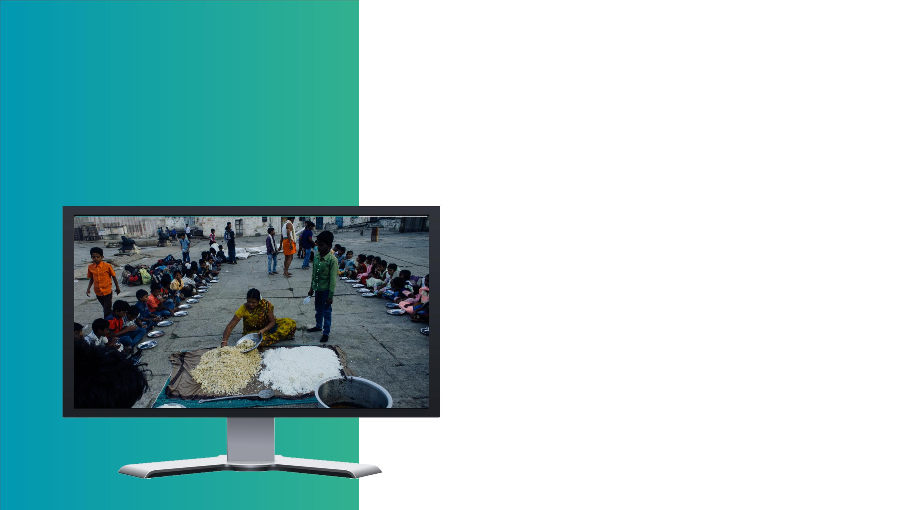
Functional
Registration functionalities:
Registration of our users as dual functionalities, users can
create, edit and delete functionalities. The registration
process is short and flexibility of the users. As attached to the
registration process users can login and use the forgot
password options. User account verifications and validation.
The Registration is also done at the level user financial
account, massaging, delivery account
Rquirement
Third-Party Integrations
Indicate which third-party software you want to add to your
new application. Or maybe you’re replatforming and wish to
preserve the systems you’re using now. This requirement
concerns both systems streamlining financial operations
(like ERP, CRM, PIM) and flexible payment gateways for
your users. Specifying the number of third-party
integrations will make financial architecture structured
and ready for your business scaling in the future.
our

Slide 8
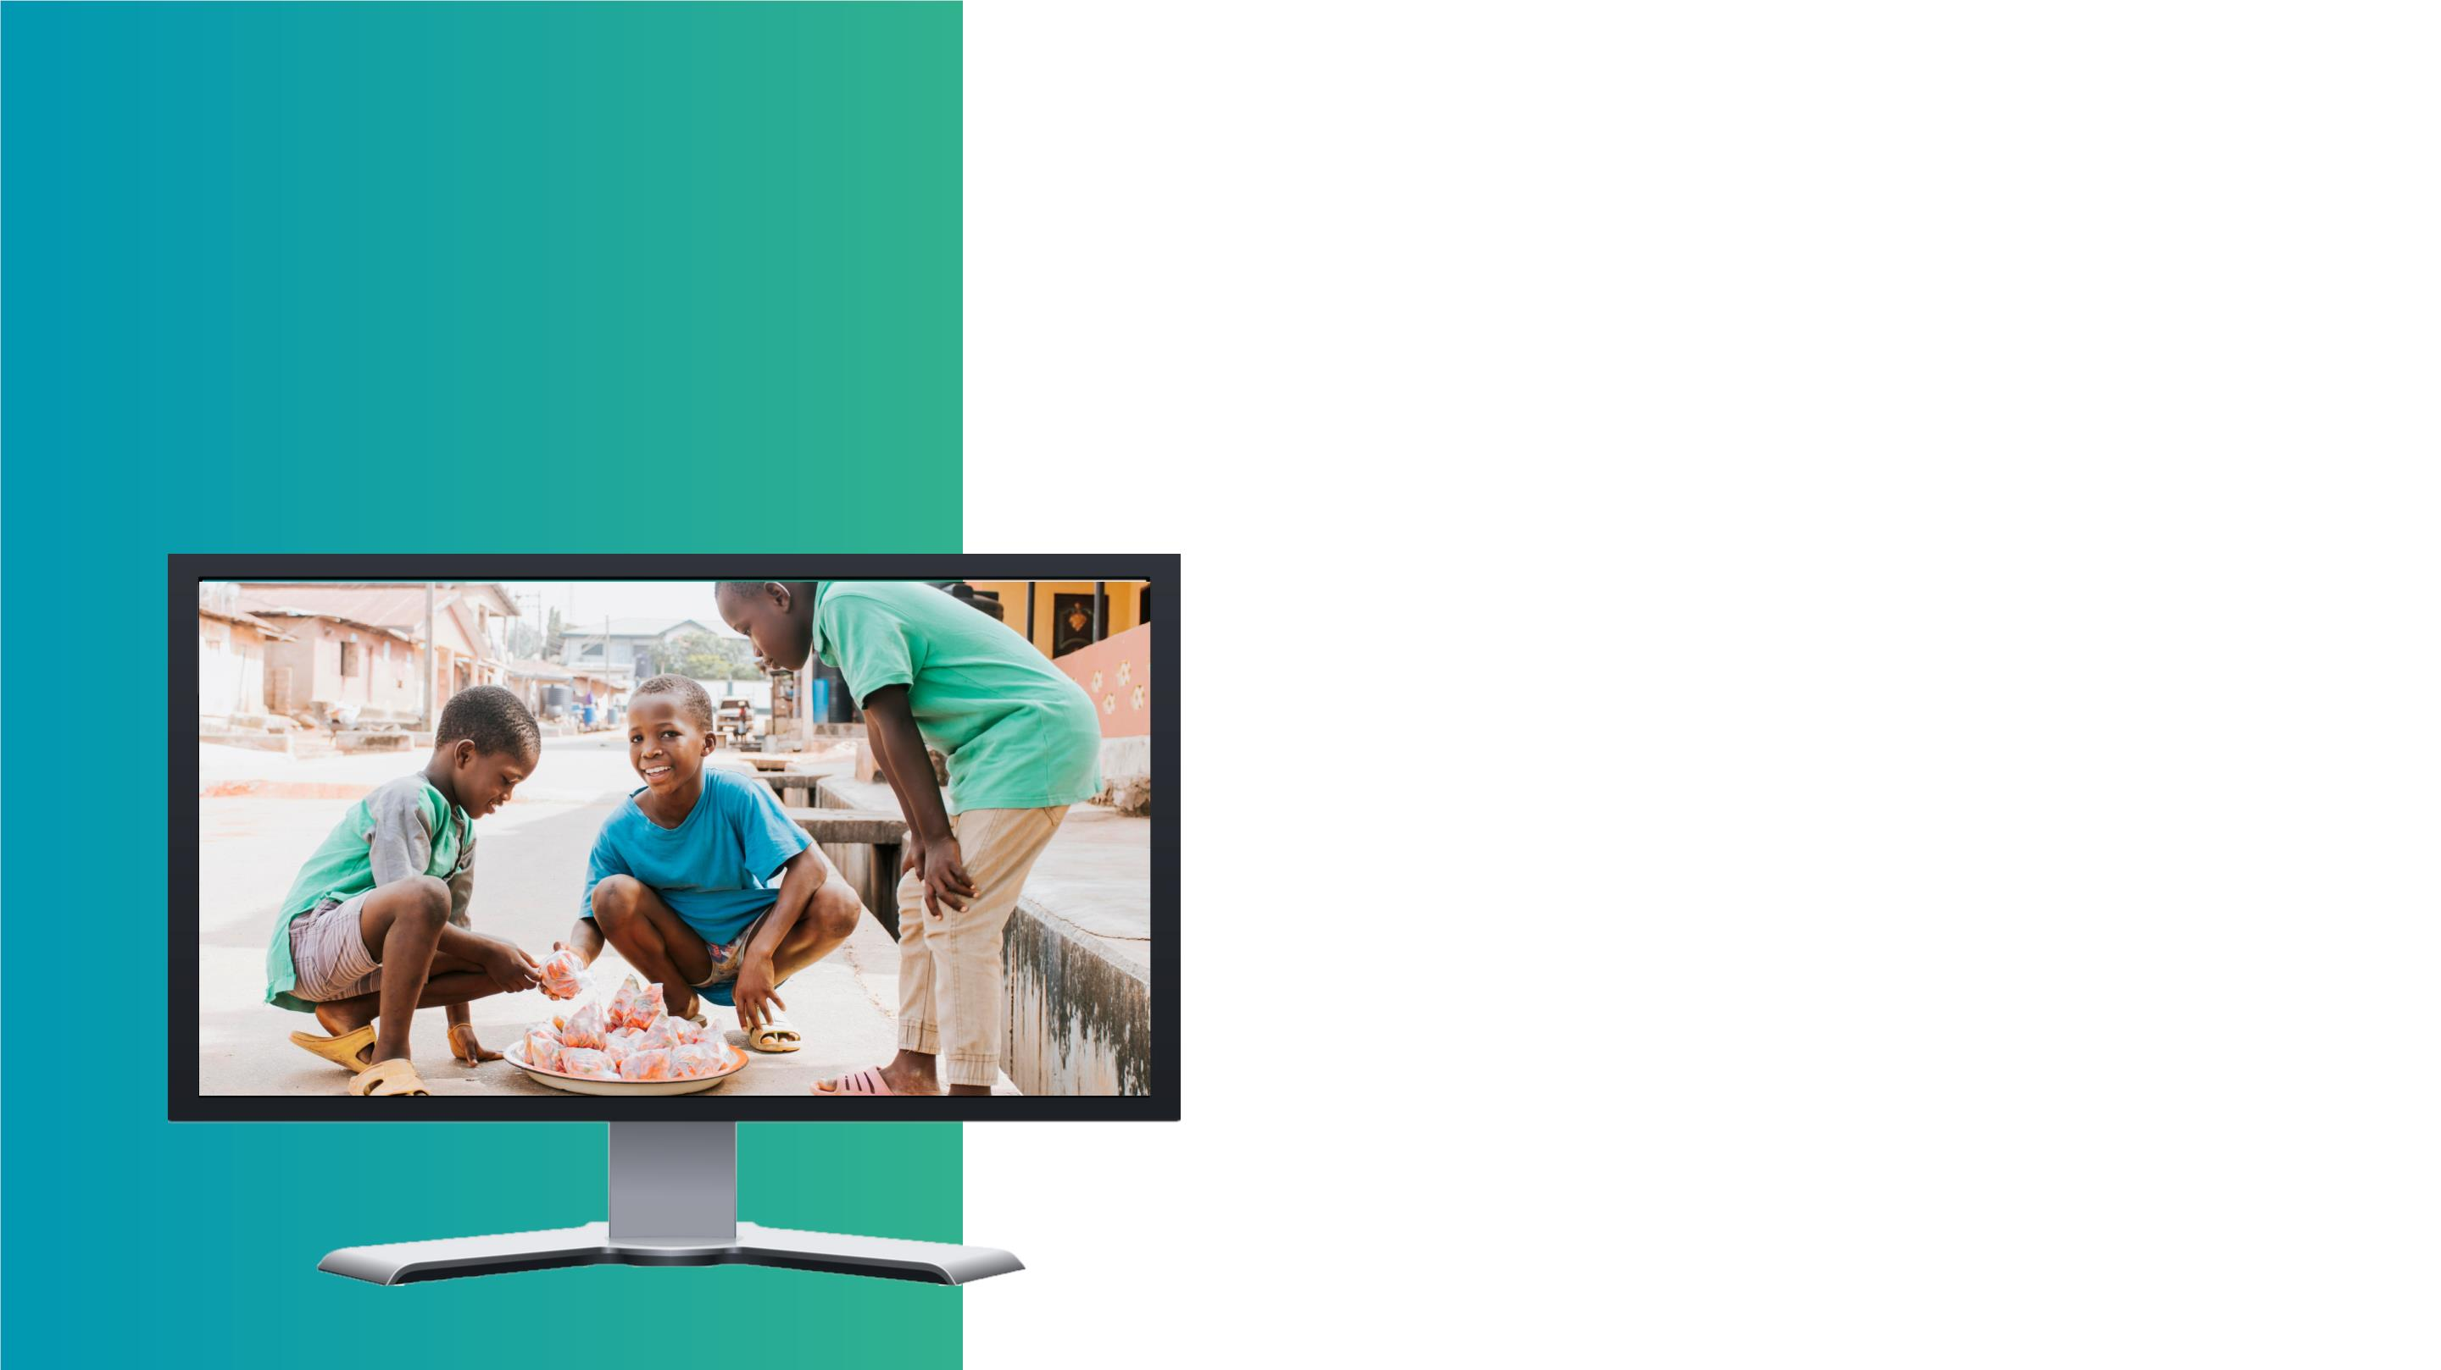
Functional
Mobile-Friendliness
It’s no secret that mobile apps (hybrid) turn to have more
traffic Statista, the number of customer conversions on
mobile devices has also reached those on desktops in the US.
So investing into a hybrid nature of your mobile application
can earn you more than a few bucks, plus loyal users making
deals at the comfort of their sofas.
Rquirement
Product Attributes
Your PDP will include various product characteristics, and
the development agency should know about them to
implement the corresponding features. Will the users be
able to choose multiple food auctions per day ? Do you use
videos on a PDP? Will some product attributes appear in a
menu (as in the mega-menu)? If possible, write out a list of
all the services of our application that is does available to the
user.

Slide 9
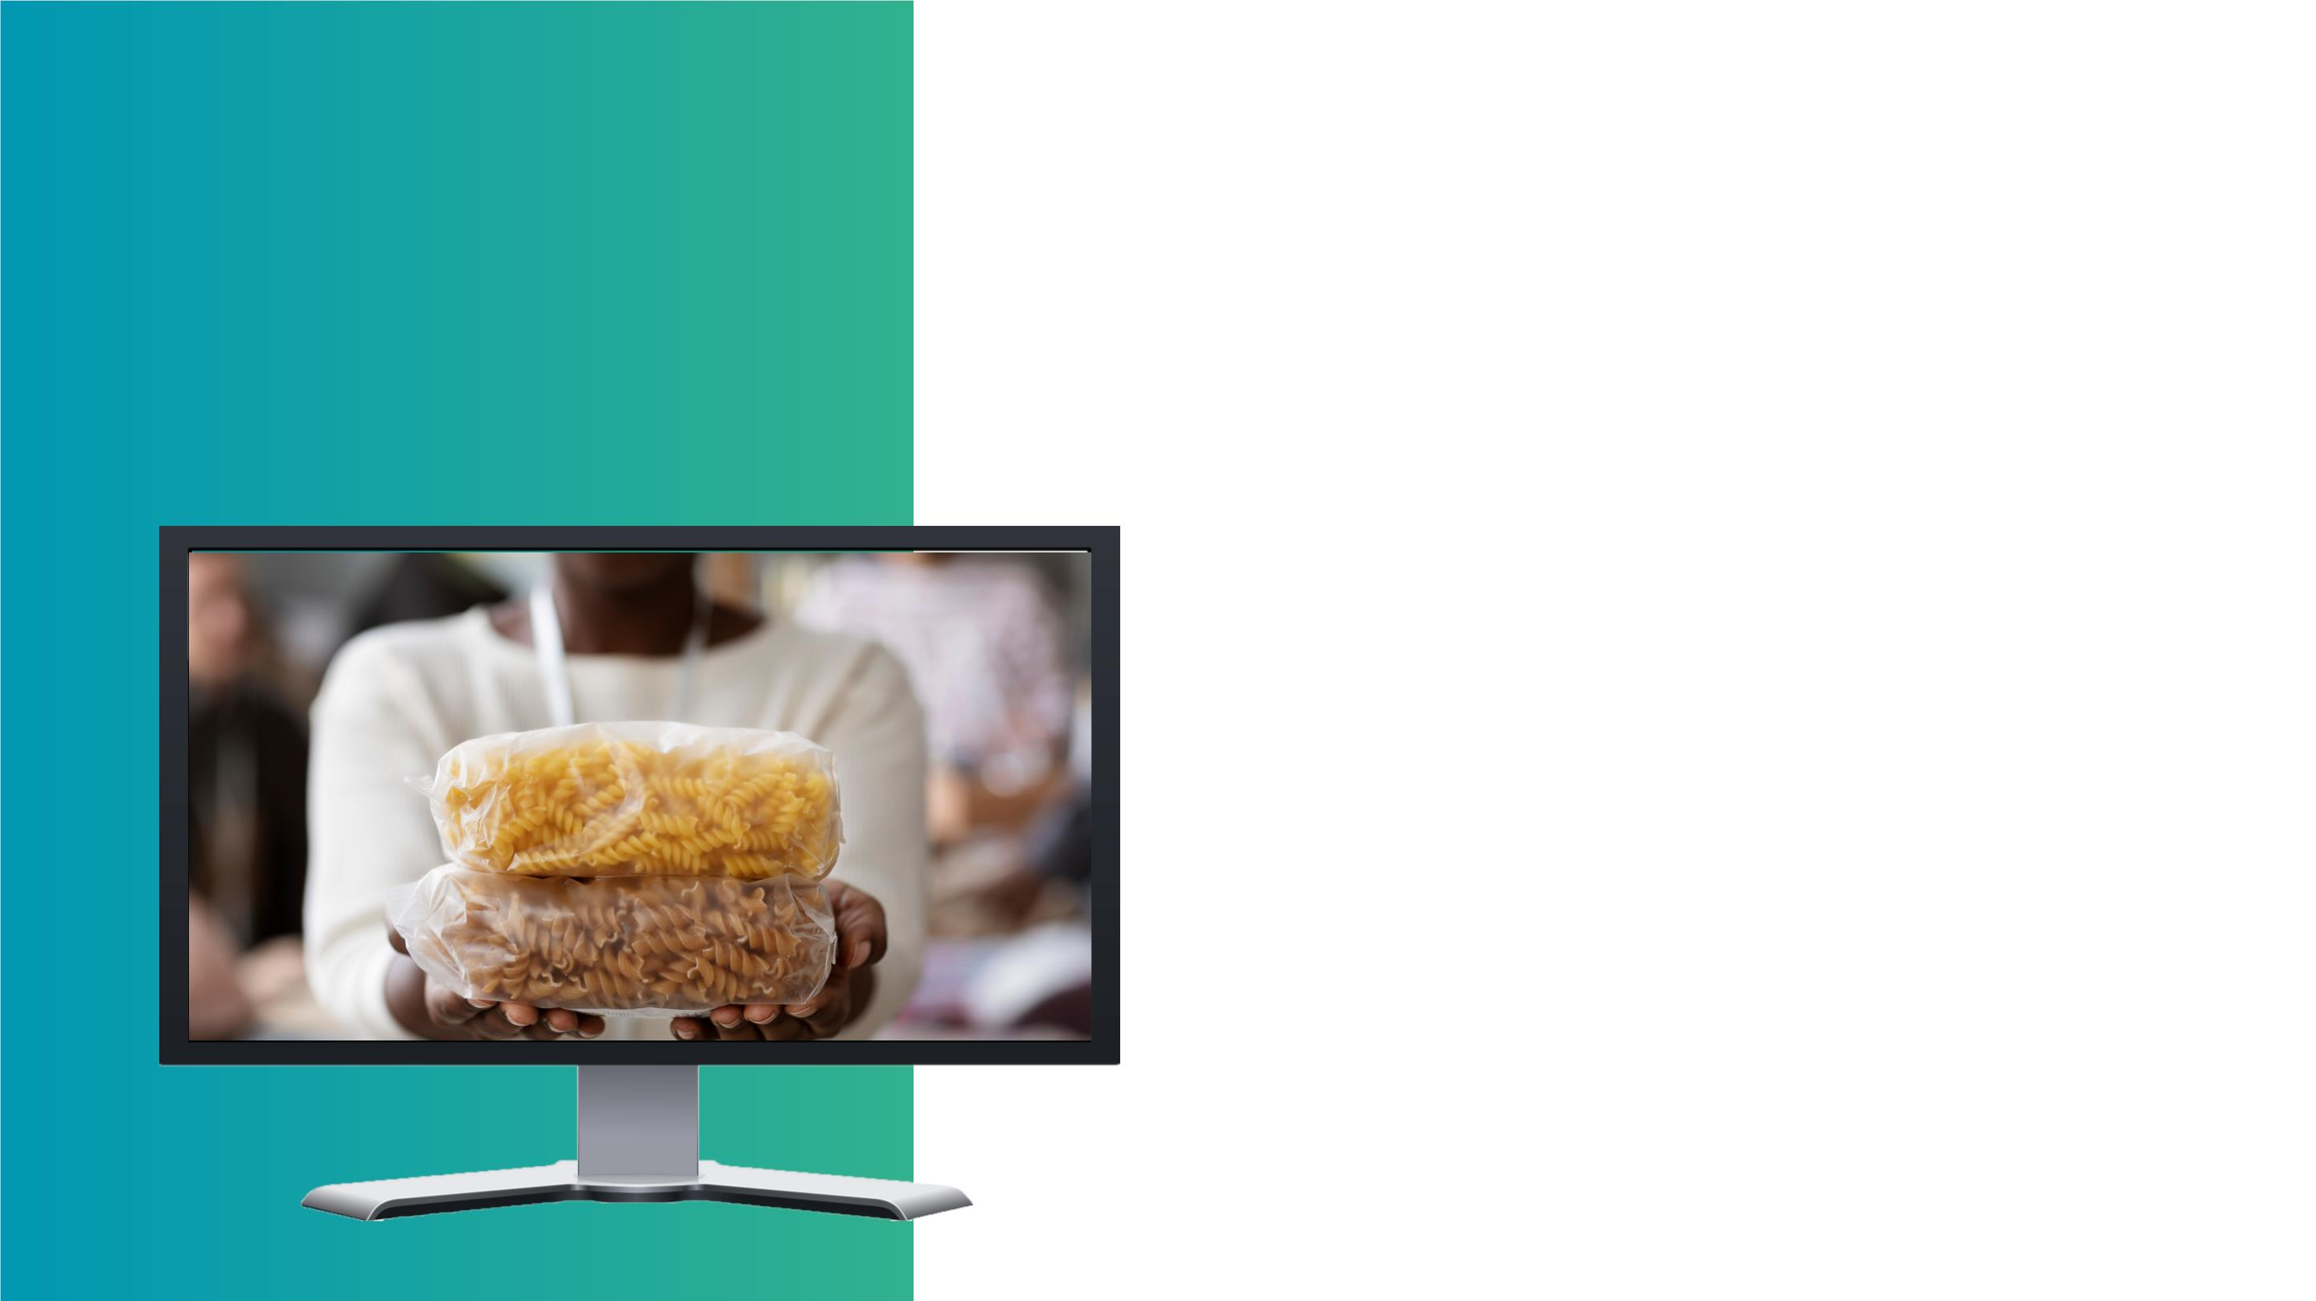
Functional
Request & Checkout Flow
Your functional requirements for an online auctioning
system s should specify how the request are processed in
your application and whether this functionality should be
optimized. In particular, indicate whether you want the user
to register to make a request of auction or enable guest
checkout. List the order statuses you want to have (visible
both to the customer and the store admin).
Rquirement
Social Sharing
Online presence goes alongside social media presence in
ecommerce. Allowing a user to share your app’s content on
social media leads to higher brand awareness and brings you
closer to your present and potential customers. Research
your target audience and identify their favorite social media
networks. Let your consumers share products, blog posts,
and inspirational pictures by adding a corresponding button
to their website.

Slide 10

Nonfunctional
Rquirement
Usability
1
2
No matter the size of your application, you want your application to be
intuitive and easy-to-use. It takes about 0.05 seconds for users to figure
your appication is worth their time and attention. So you’ll definitely wan
work on your homepage design, calls-to-action, and easy checkout to get
those milliseconds of doom. Website usability is also defined by
Security
Security is paramount while dealing with monetary transactions and sen
data. A simple hashing encryption and data privacy policy will instill trus
your our application convert the customers into your brand advocates. It
also about different admin roles allowing you to control who can create, s
copy, change, or delete information. Depending on your business locatio
security also means complying with the customer data protection rules (c
in point: GDPR in Europe).
3
Performance
If your goal is increasing your application traffic, performance should be
priority NFR in your specification document. This NFR is often found in
from large enterprises or websites with legacy architecture: they want the
stores to load fast no matter the number of integrations and sales season
up the speed benchmark, a maximum number of SKUs to be added, or an
other performance indicator suitable to your business

Slide 11

Nonfunctional
Rquirement
Maintainability
4
5
It’s widely known that the tricky part of planning a business budget is
accounting for the operational costs of business maintenance. Striving to
make the website maintainable from the initial development phase mean
cutting the time and cost to identify and resolve the system faults in the
future. As saddening as it may seem, there’s no escape from the future is
and you can see many cues on how to maintain an ecommerce website. B
your task is to make the system easy-to-maintain right from its launch.
Scalability
If you’re looking into a future-proof solution, scalability should be your t
This requirement defines how the application can grow and expand its
functionality without affecting its performance. You should be able to ad
more memory, servers, or disc space to complete more transactions on y
website.
On the server-side, you might want to add localization features in case yo
plan to enter new markets and sell products internationally. Overall, this
accounts for painless business expansion and has both hardware and sof
implications.

Slide 12

Requirements analysis!!
Also called requirements engineering, is
process of determining user expectations
a new or modified product. These featu
called requirements, must be quantifia
relevant and detailed.
requirement specification !!
Software Requirements Specifications, a
known as SRS, is the term used to descri
an in-depth description of a software produ
to be developed. It's considered one of t
initial stages of the software developme
lifecycle (SDLC). Think of it like the map th
points you to your finished product.

Slide 13
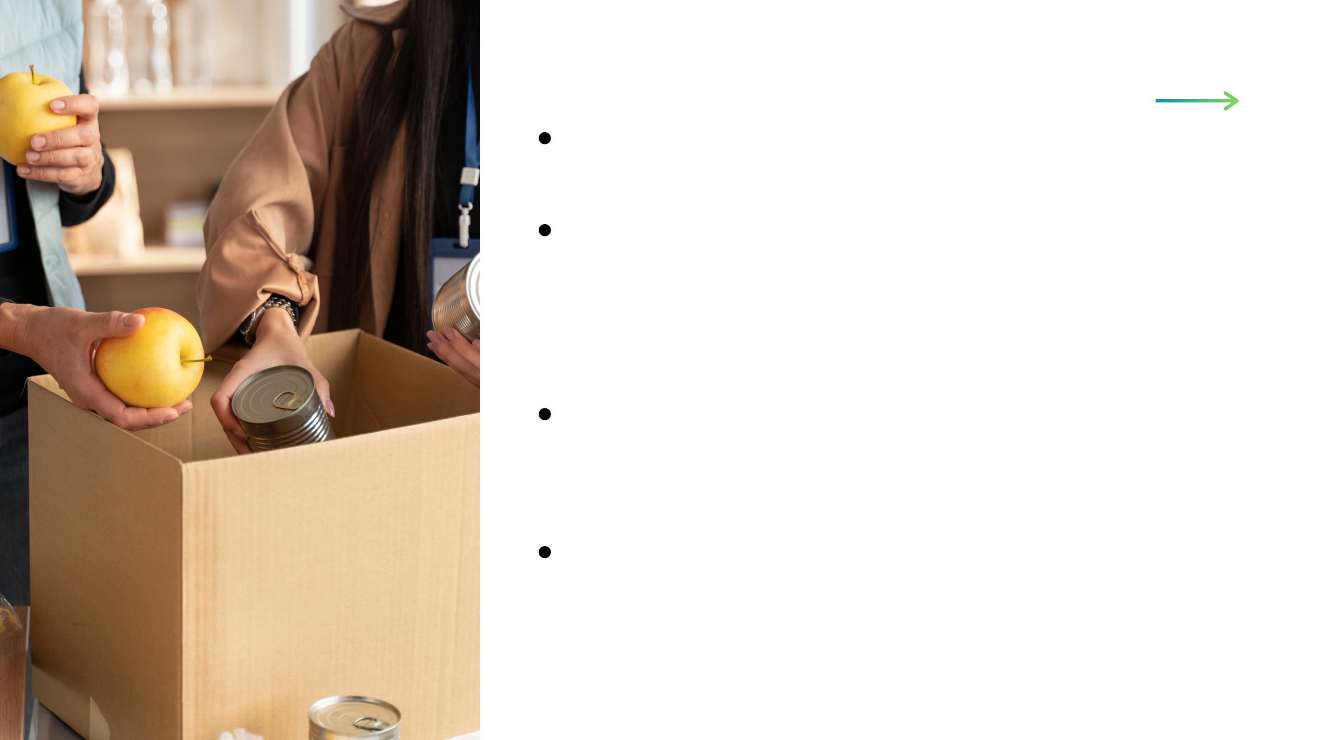
System requirement
Requirement
specification
The system consists of three views
donor(Auction, charity), food_collector, Admin.
Food donor could be an individual organization,
food donor can also collect food as well as
collectors can also can also donate food (on
auction or charity).
Admins: They control all the activities, manage
user data, system errors and bugs, manage
donation post and system transactions
Donors (organizations, individuals): They can
post food they are given out either for
free(charity) of small price (auction price)
collectors are

Slide 14
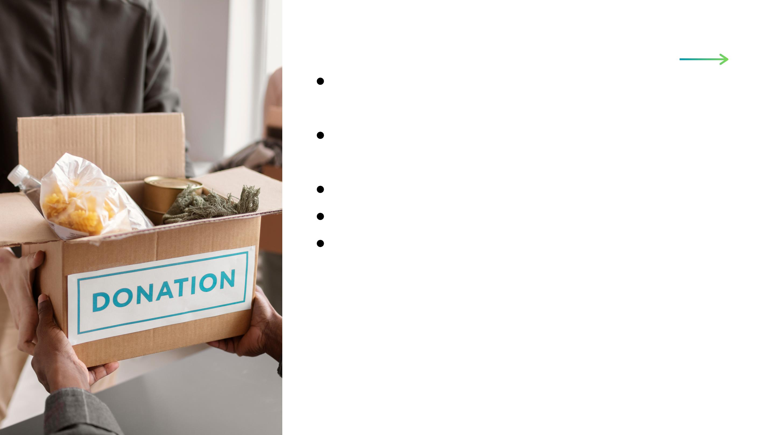
System requirement
From donors at arranged locations at allow for a
reduction in the price.
Collector: They collect food stipulated
agreements
Each user should have an account.
Each use has a wallet account
The application provides signup, login and logout
functionalities.
Requirement
specification

Slide 15

User Reequipment
Each and every user has ability to auction and take food on
auction
Each user has an account
Each user can register to the application
Users have notifications about available auctioned food
Users can make compensation or pay gifts to auctioned food
Users can delete account their account from the auction food
sides if not in use
Requirement
specification
Users can take many donation food at the same time // due I
don’t know If I should not my be users should only be allowed
to take one auction in a day.
Users can make collections
Users can build and update profile
Users can exchange messages
Users share food donation post

Slide 16

Donor Reequipment
Donors can make food donation advertisement on available food
Donors delete food donation post
Donors can make food donations free or open for minimum auctioning
Donor can mark auctioning debatable or not (enable negotiations,
disable negotiations).
Requireme
specificatio
Donor can view the donation history
Donors view collector profile
Admin Reequipment
Admins can delete food donation post
Admins can manage user data in database
Admins can view all the pending donations along with status.
Admins can view all the donations that they have received.
Admins can also view all the agents in the application.
Admins can delete user account
Admins can delete Food request

Slide 17
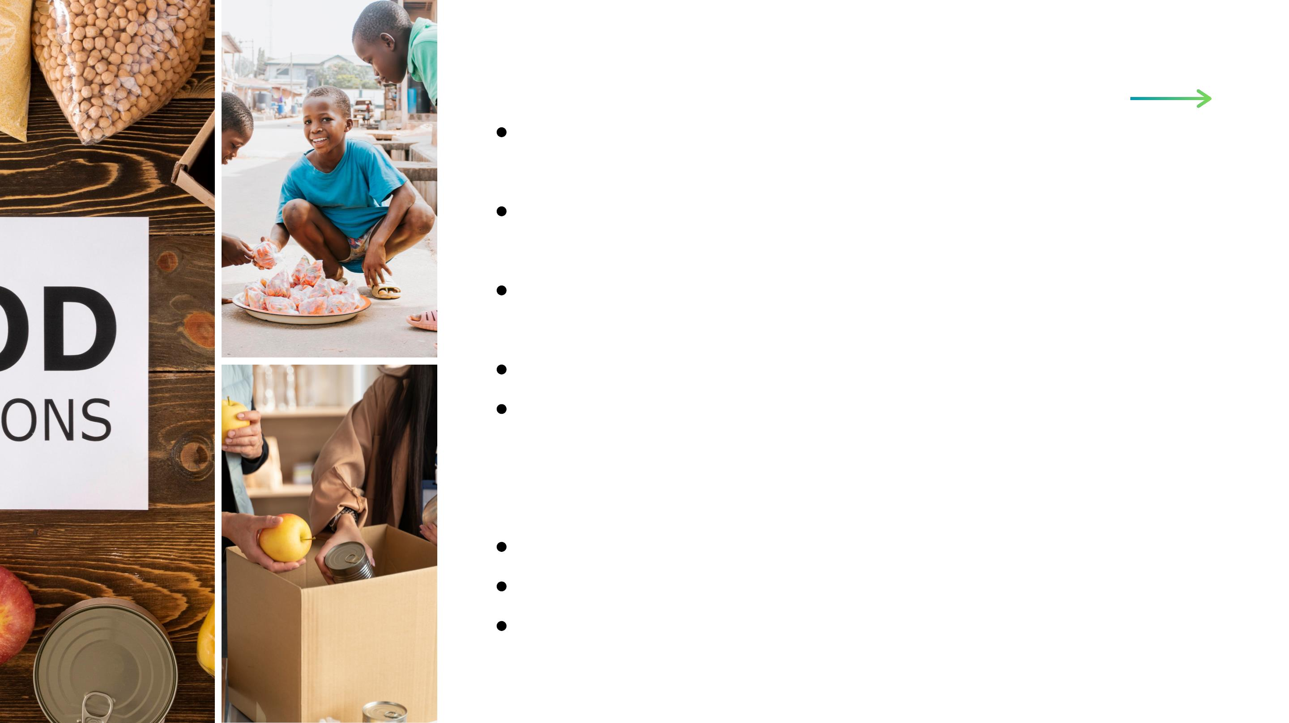
Collector Reequipment
Collector will receive notifications from admins to collect
food from donor's homes.
Collectors can mark their collection upon collection of food
from donor's home.
Requirement
specification
Collectors can also view all those food donations which have
been collected by them previously.
Collectors can recommend Donors.
Collectors can make food request
Technology Reequipment
Java
SQL
Firebase

Slide 18
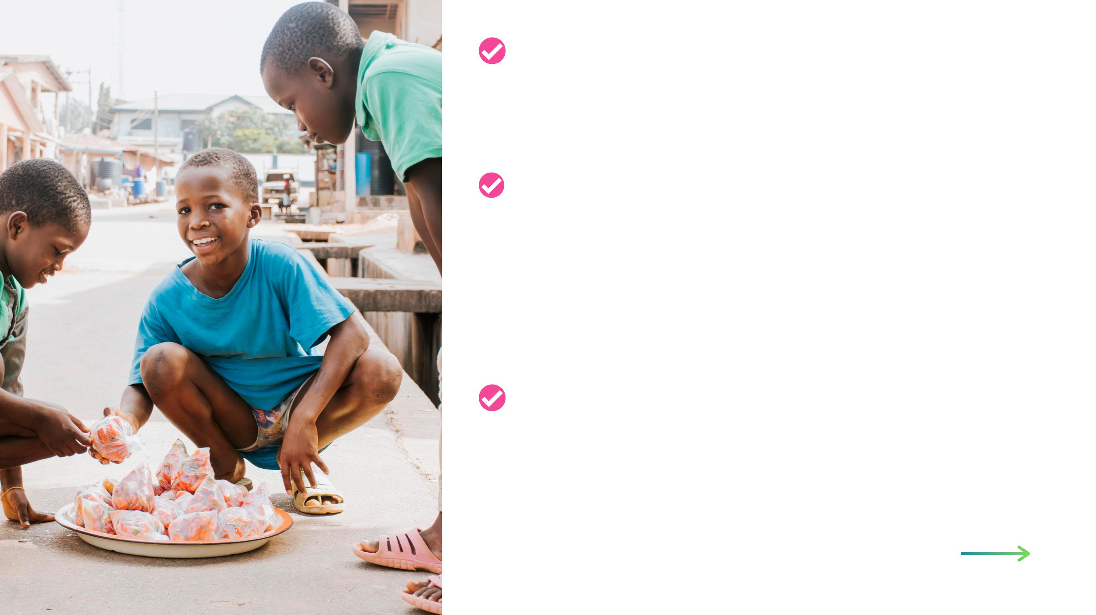
Installation and Setup
1.Android Studio
2.Canvas
3.StarUml
For running the application:
Requirement
specification
1. java must be installed on the
system.
2.You should have a Firebase
database.
3.You should have a code editor
(preferred: Android Studio)
Installation and Setup
1.Download the source code in the
desired location on your system.
2.Open the code in your code editor.

Slide 19

Phone Number
679 376 522
We'd love to
hear from you!
Email Address
alkaliod111@gmail.com
Reach out to our team to get for any inquiries
or clarifications.
Website
www.foodauctions.cm

